Slide 1
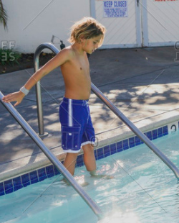
Why do we do gradual exposure?
If you jump into the deep end of a cold pool on a hot day, it feels freezing and you might want to jump right back out because it is a shock to your system. It feels uncomfortable! But if you wade in slowly from the shallow end, you get used to it as you go and soon you can be comfortably swimming in the deep end!

Slide 2
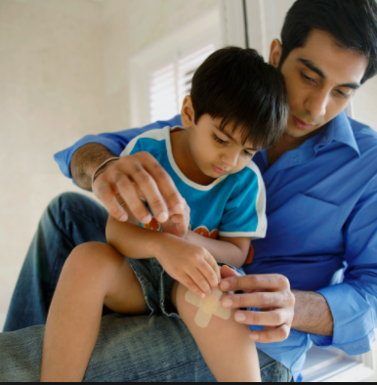
Why do we do gradual exposure?
“If you fall off your bike and have a big bloody wound and you don’t take care of it, what will happen? If you keep ignoring it, it will get infected and even more painful. Eventually you will have to go to the doctor to have it treated and it will leave a big scar. But if you treat it right away, it will sting a little, but then it will heal better and the scar will be so small no one will see it unless you point it out.”

