Slide 1
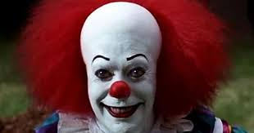
What are your thoughts?
What are your feelings?

Slide 2
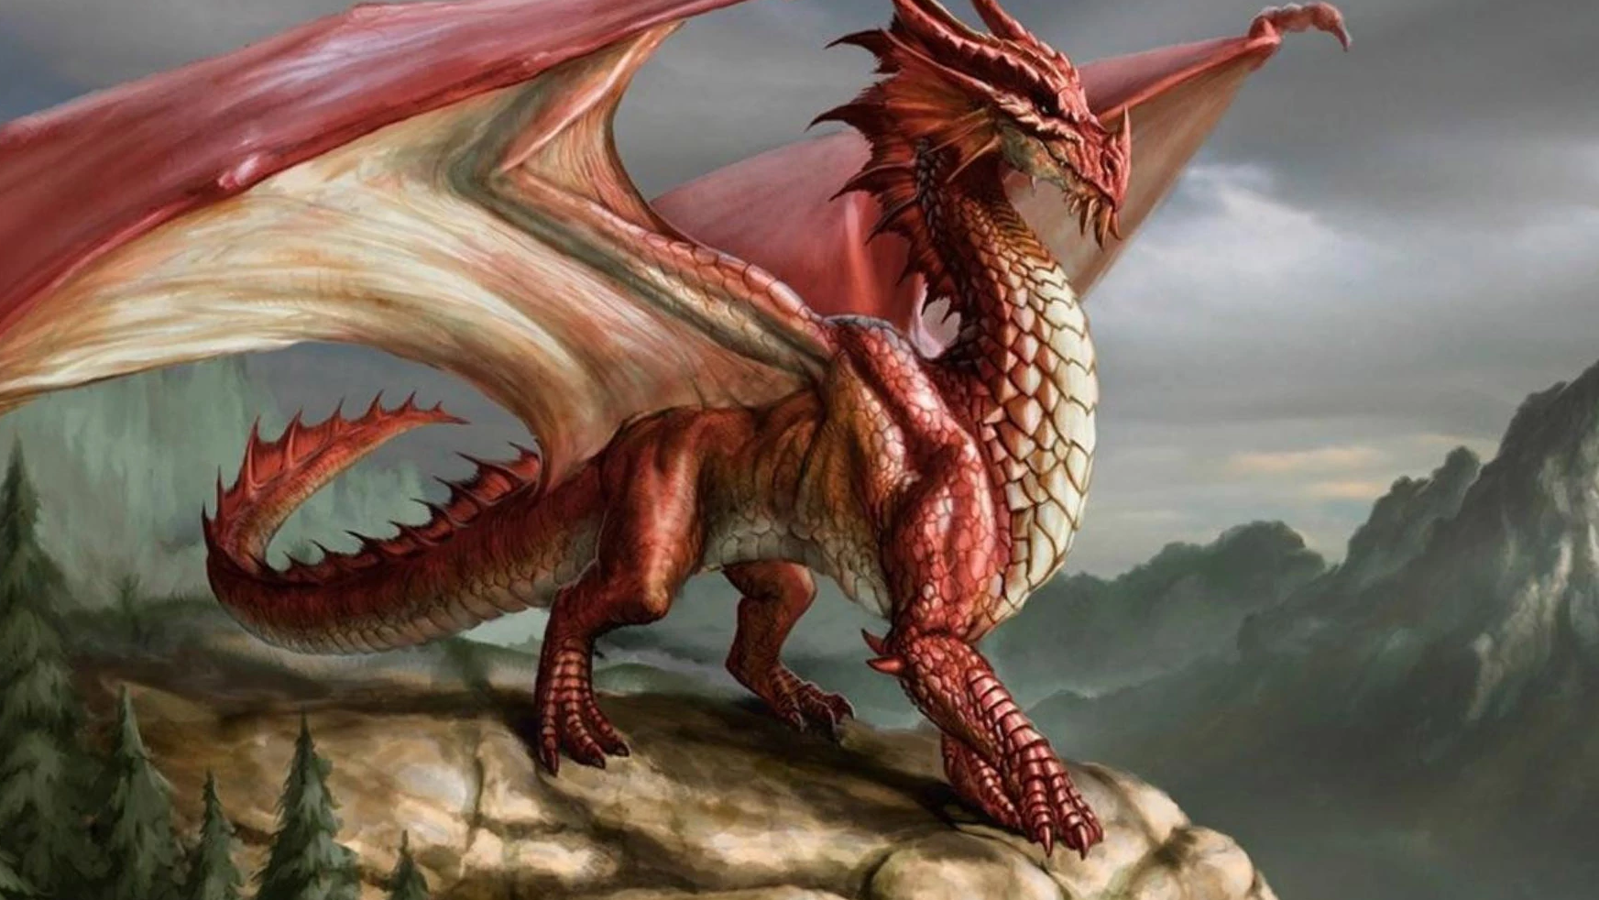
What are your thoughts?
What are your feelings?

Slide 3
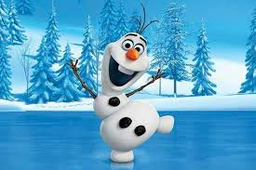
What are your thoughts?
What are your feelings?

Slide 4
What are your thoughts?
What are your feelings?

Slide 5
What are your thoughts? What are your feelings?

Slide 6
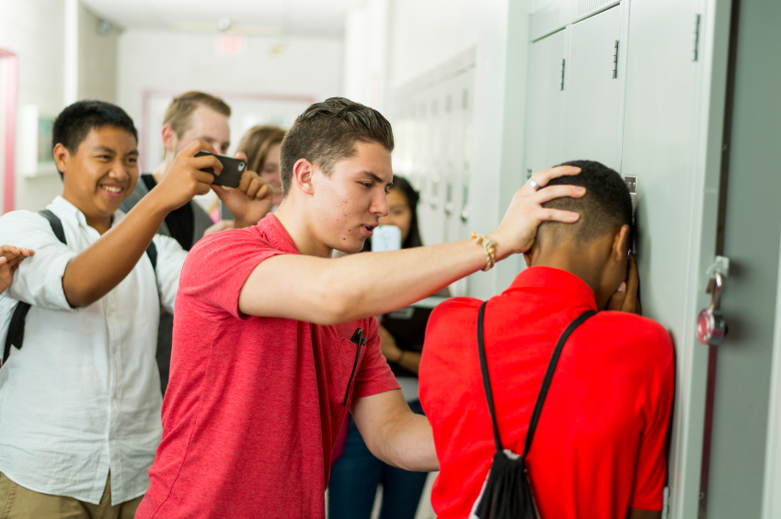
What are your thoughts?
What are your feelings?

Slide 7
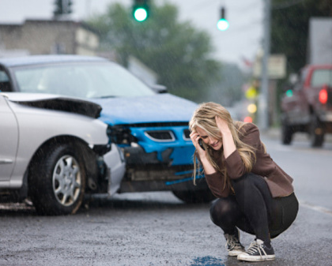
What are your thoughts?
What are your feelings?

Slide 8
What are your thoughts? What are your feelings?

