Slide 1

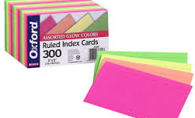
Donna Potter, 2016

Slide 2
Donna Potter, 2016

Slide 3

Donna Potter, 2016

Slide 4

Donna Potter, 2016

